Slide 1

XMT School
Teaching done right

Slide 2
About the project
The XMT school project is a representation of what schooling could be like in the future.
XMT allows you to test your students through a modern website with nearly no effort.
It takes no more than 5 minutes to append a new test to the website and even less to see the marks on the test, using our powerful teacher’s app.
It’s even easier to take the actual test, as the only thing holding you back is your knowledge on the topic the test is based upon.
The API is set to be as efficient as possible whilst being as secure as possible, a best of both worlds.

Slide 3
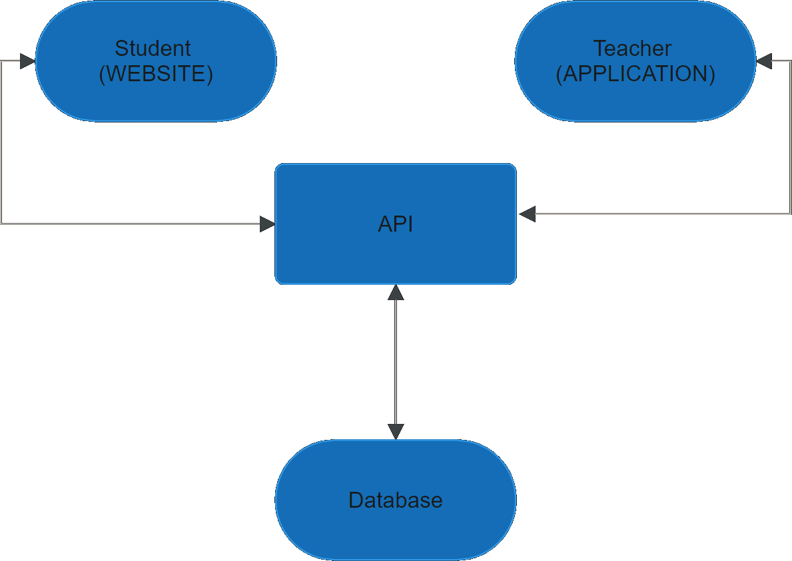
The structure

Slide 4
Simply brilliant
THE WEBSITE | The app | The API | The database
Front-end | Front-end | Back-end | Back-end
Made in React | Made in WPF | Made in ASP.NET Core | Controlled with Entity Framework
Mobile friendly | Highly capable & easy to use | Efficient & secure | Organized and structured to the highest standards

Slide 5
The website
The website was made with React and is set to last for years to come.
That is why it is both desktop and mobile friendly, whilst retaining a sleek modern metro feel.
The website allows the students of the school to view and take the tests set by their teachers.
It also allows for various other perks such as checking your profile and viewing information on the school on the home and about pages.

Slide 6
The website - Tabs
The website has a couple tabs, and here’s a breakdown of the various tabs:
Home – The home page for the website
About – The about page for the school
Login – The page used to log into your user account
Take a Test – Where students may view or take tests
Tests Manager – Where administrators and teachers can download the management app
My Profile – A page designed to view the basic info of your user
Logout – Not really a page, used to log out of your currently logged in user

Slide 7
The website - Modules
Most modules used are to be expected (such as the React module), but here are some of our custom modules that are less frequently seen:
datatables.net-dt – Used to display data in a visually pleasing (and functional) table
react-icons – Used for various icons throughout the website
react-router-dom – Used for proper navigation through the website
react-toastify – Used for notification toasts on the website
typescript – We chose to use TypeScript as opposed to just JavaScript

Slide 8
The app
The app was made with utility and efficiency in mind.
It is primarily used for managing users and tests but allows for viewing marks as well.
It is the hub of teachers (and administrators alike) to view and manage the school from behind the scenes.
The app was made in WPF, that is why it can only be ran on the Windows OS and not anywhere else, but it wouldn’t be too hard to port it to another device given enough time and effort.

Slide 9
The app - Views
LoginWindow | Used to log into the app.
MainWindow | The hub, featuring tabs for the various actions on the app.
UserModifyWindow | Used to modify/create a user.
TestModifyWindow | Used to modify/create a test.
QuestionModifyWindow | Used to modify/create a question.
AnswerModifyWindow | Used to modify/create an answer.

Slide 10
The app - Packages
Here are the used Nuget packages for the app:
ModernWpfUI – Allows for a much more modern metro theme as opposed to the default classic theme.
Newtonsoft.Json – Allows for conversion of types to Json and vice-versa for the communication API.

Slide 11
The API
Everything you see on the front-end goes through the API.
Whether it’s something as simple as logging in or something as big as creating a new test, the API is the middle-man between the front-end and the database.
It’s needless to say that a program with such an important role in the project needs to do its tasks securely and efficiently.
Thus, the API was built with security and efficiency in mind before everything else.
But that’s not to say that it’s incapable of advanced tasks, as it can handle highly complex and detailed sets of instructions.

Slide 12
The API - Packages
Here’s a list of the Nuget packages used in the API:
Swashbuckle.AspNetCore – Used for the Swagger API
Microsoft.EntityFrameworkCore – Used to communicate with the database
Microsoft.EntityFrameworkCore.SqlServer – The database we used was a SQL database
Microsoft.EntityFrameworkCore.Tools – Dependencies
Microsoft.EntityFrameworkCore.Design – Dependencies
Microsoft.EntityFrameworkCore.Abstractions – Dependencies
MySql.EntityFrameworkCore – We used MySql for our database software
MySql.Data – Dependencies

Slide 13
The API – Login

Slide 14
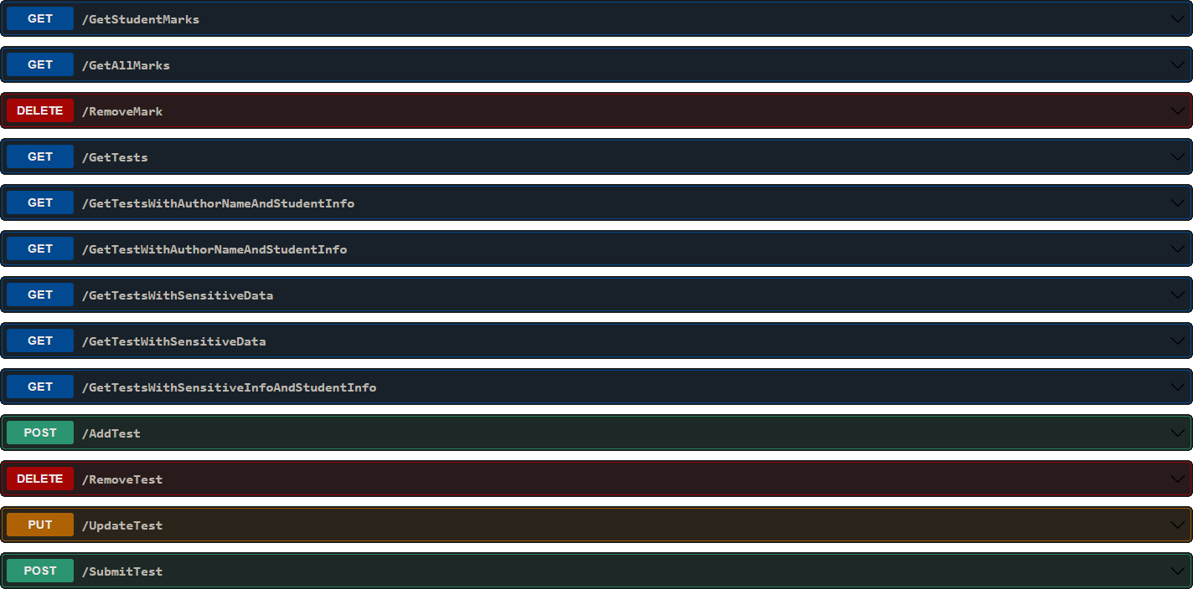
The API – Tests

Slide 15
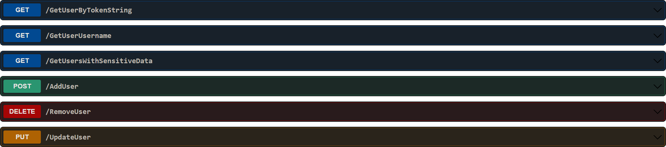
The API – Users

Slide 16
The database
The database is where all the data is saved, which won’t surprise anybody, but the way it is saved is what’s important.
Here in XMT, we use conventional methods of storing data in a properly structured way in a database, and that is because we use Entity Framework to manage the structure of our tables.
This helps keeping the database secure, consistent, clear to use and efficient.

Slide 17
The ones behind it all
A project can’t exist without the people who made it.
This project was made by Shimon Levy and Alon Turgeman.
While Shimon primarily focused on the back-end, Alon focused on the front-end.
But in the end the both of them had to intervene in either part of the project to ensure proper compatibility.

Slide 18
To the future & back
Embark on a journey into the future with XMT School, a project that fuses innovation with timeless wisdom.
Designed with the future in mind, our sleek website offers a modern platform for seamless test-taking.
The API, aptly named the intersection of the whole project, acts as the connective tissue, facilitating smooth communication between the website, app, and the heart of it all – our dedicated database.
Here's the secret sauce: although we're all about the future, we cherish the lessons of the past.
XMT School uses the wisdom of yesterday as a guiding light, ensuring that as we evolve, we carry with us the best practices that stand the test of time.
It's not just about progress; it's about creating an educational experience that's rooted in the past yet firmly steps into the future.

Slide 19
Bonuses
For this demonstration, the project is running live off a real VPS which both allows it to run 24/7 and it also allows the project to simulate what it would feel like if it were to be used in production.
The VPS is running on the Debian 12, Linux OS.
The website is hosted using Apache HTTP Server on the VPS.
The API is running on the VPS.
The database is hosted using MySQL Server on the VPS.
The application is not server dependent but the download for it is hosted on the website (which is on the VPS).

Slide 20
Final points
This is a huge project, and it is capable of so much more if the future calls for it, this is because the project is modular, dynamic and modern.
The XMT project took months to prepare and create in a way that we could say is ready for production.
The XMT school project is capable of much, much more than we’ve discussed, as there’s only so much you can show in a presentation.
Thank you for your attention.

